Slide 1
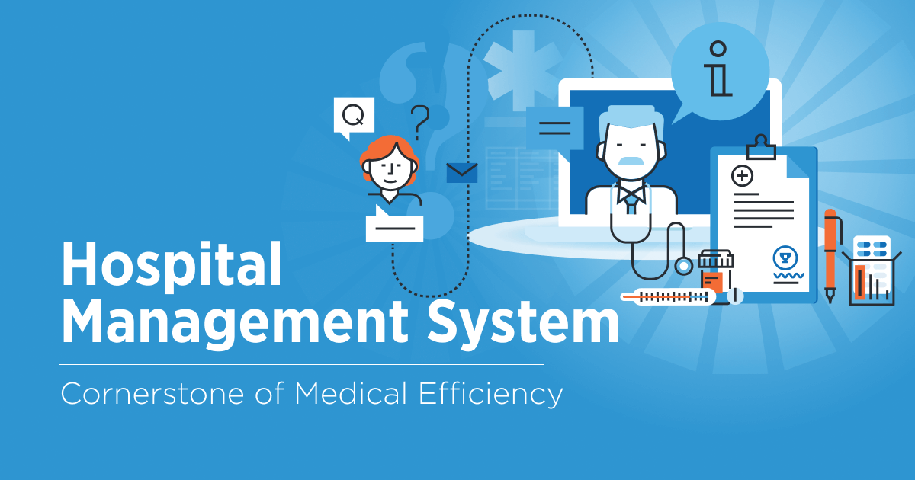

Slide 2
Hospital Management System
A Hospital Management System (HMS) is software used to handle and simplify different tasks in a hospital. It brings together many parts of hospital work into one system to make things run more smoothly, ensure information is correct, and make it easier to access.

Slide 3
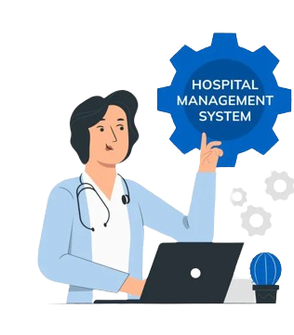
Patient Registration
Appointment Scheduling
Billing and Payments
Medical Records
Staff Management
Appointment and Prescription Management

Slide 4

Concepts used in HMS
1. Abstraction:
Creating abstract classes or interfaces for general concepts like User, Appointment, and Payment so that different types of users (e.g., doctors, patients, receptionists) can interact with these abstractions without needing to understand the underlying complexities.
2. Encapsulation:
Using private fields and public methods in classes like Patient, Doctor, and Payment to control access and modification of their data, ensuring data integrity and hiding implementation details.
3. Inheritance:
Creating a base class User and extending it to Doctor, Patient, and Receptionist classes. This allows for code reuse and a hierarchical structure that reflects the real-world relationships between different user types.
4. Polymorphism:
Overriding methods in subclasses like Doctor and Patient to provide specific implementations while using a common interface or base class. For example, the toString() method is overridden in various classes to provide class-specific string representations.

